Slide 1
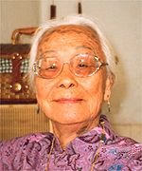
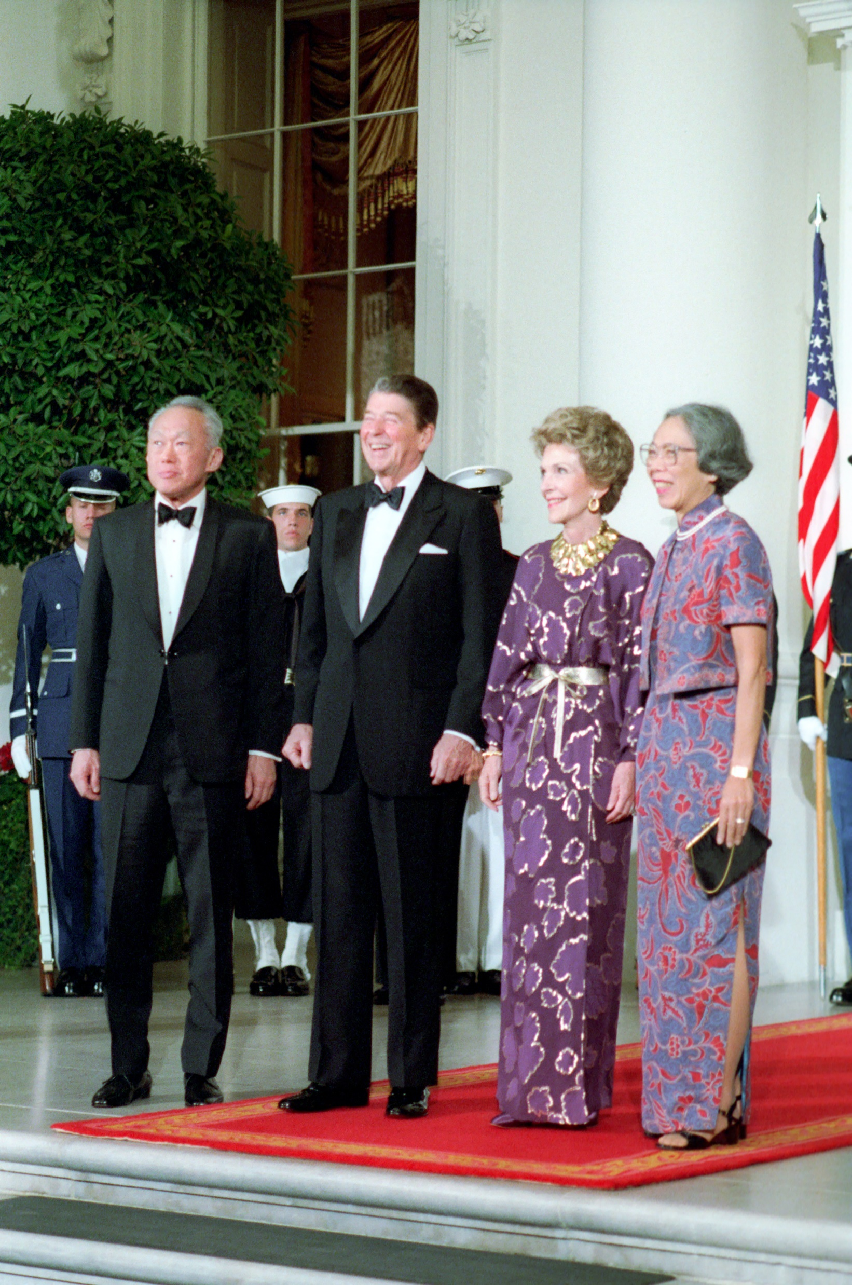
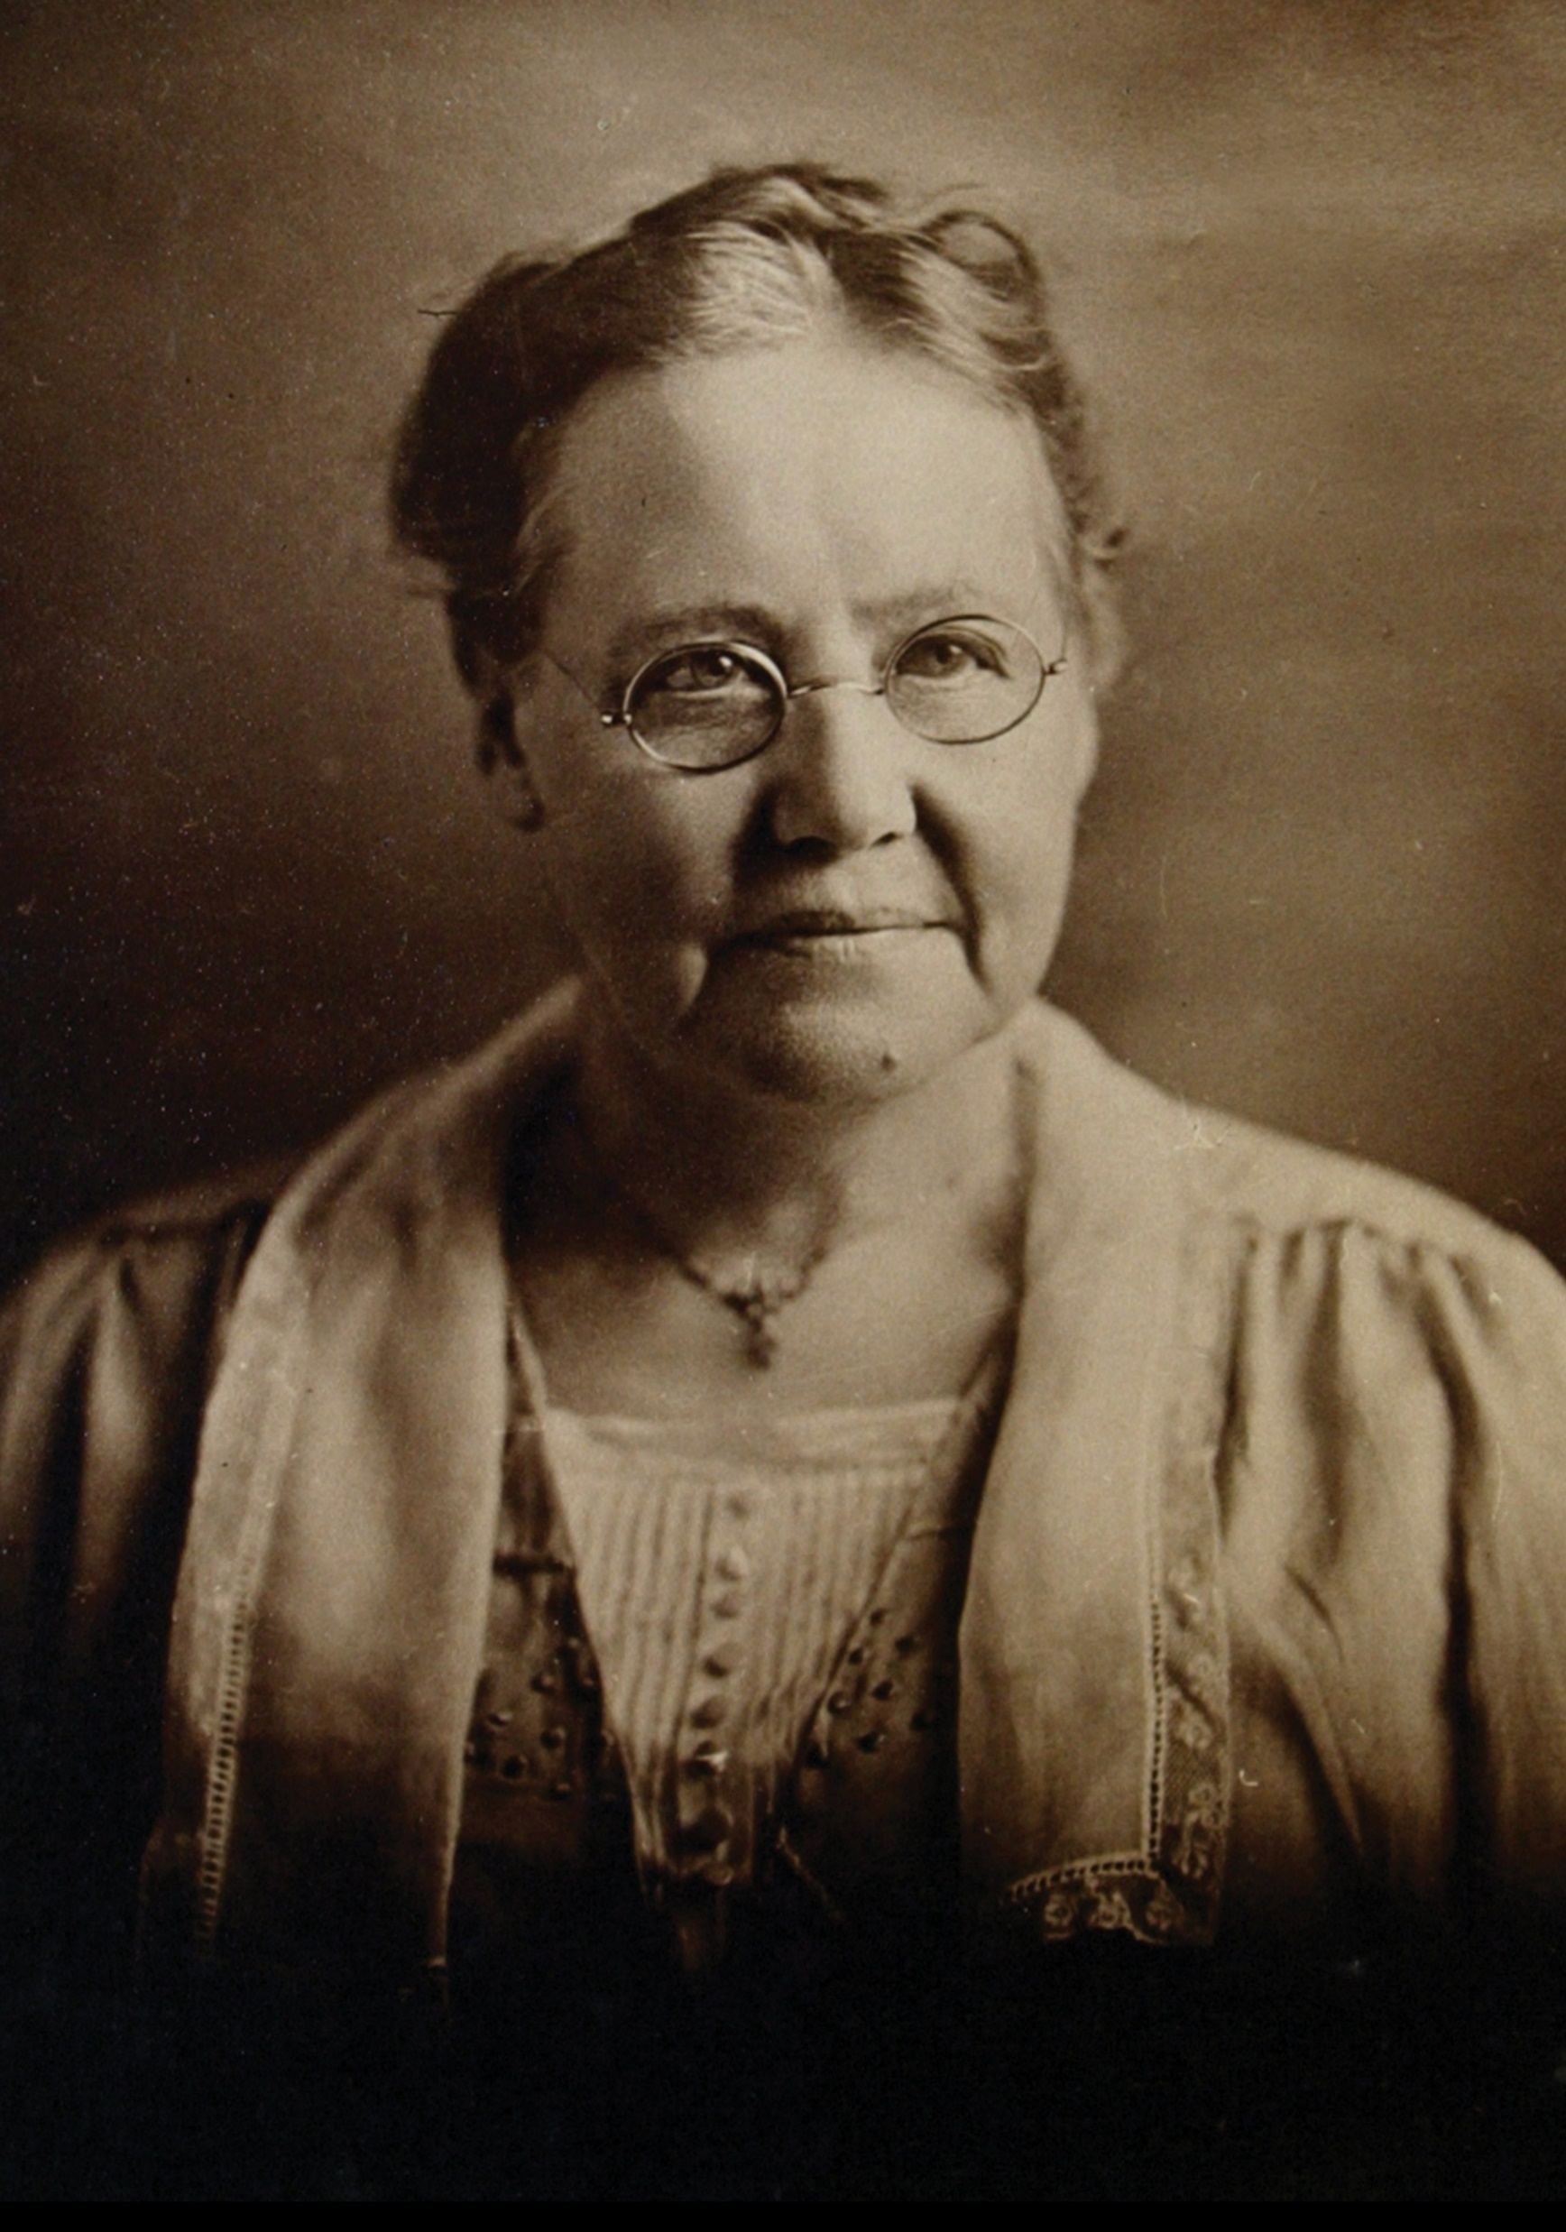
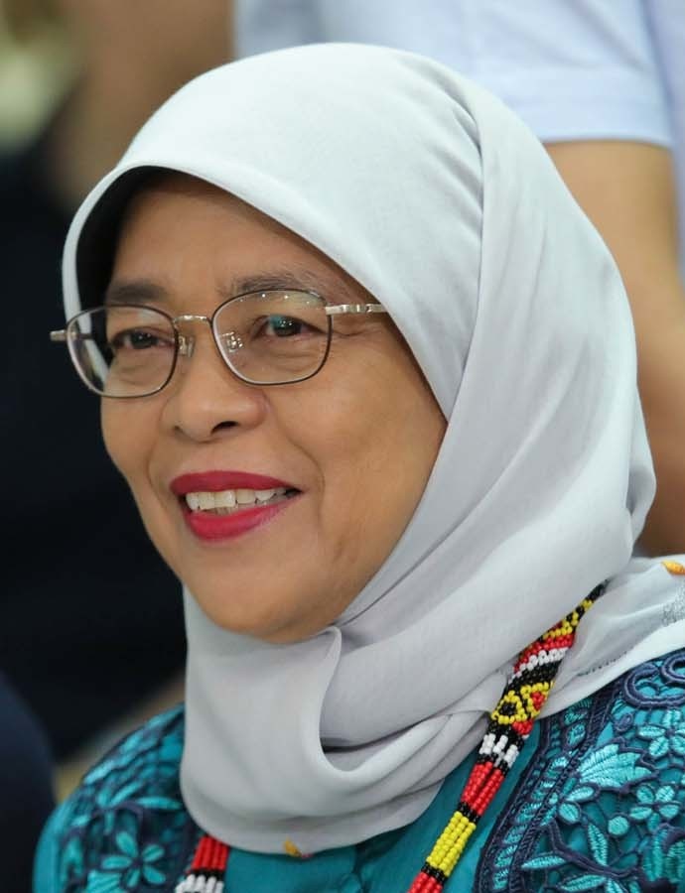
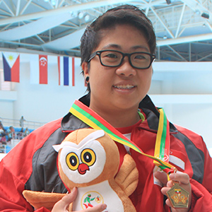
Women History Month
Elizabeth Choy
Kwa Geok Choo
Sophia Blackmore
Halimah Yacob
Theresa Goh
Amazing Women Pivotal to Singapore’s Growth

Slide 2
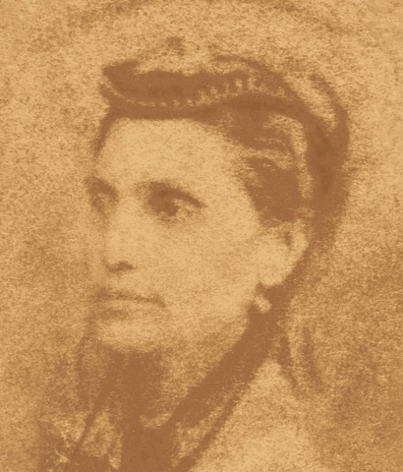
AGNES JOAQUIM
Her Life
Botanical Achievements
She bred Singapore’s first hybridised orchid hybrid, Vanda ‘’Miss Joaquim”.
She won prizes at annual flower shows, and the Vanda Miss Joaquim was the rarest orchid at the 1899 annual flower show.
The orchid was chosen to be the national flower among forty contenders.
Agnes Joaquim was a Singaporean Armenian, an avid gardener, an active Armenian Church member and skilled at embroidery.
In 2015, Agnes was inducted into the Singapore Women’s Hall of Fame.
Image courtesy of Wikimedia Commons

Slide 3
ELIZABETH CHOY
Pre-War
Japanese Occupation
Post-War
Volunteered as a nurse during the Japanese Occupation.
She and her husband brought the prisoners of war clothing, letters and medicines.
She leaned on her faith when she was subjected to torture and imprisonment.
She taught at St Margaret’s School, and St Andrew’s School to pay for the tuition fees at Raffles College (now National University of Singapore).
For assisting the British prisoners-of-war, the Choys were bestowed the Officer of the Order of the British Empire, and Elizabeth got to meet Queen Elizabeth.
Image courtesy of Wikimedia Commons

Slide 4
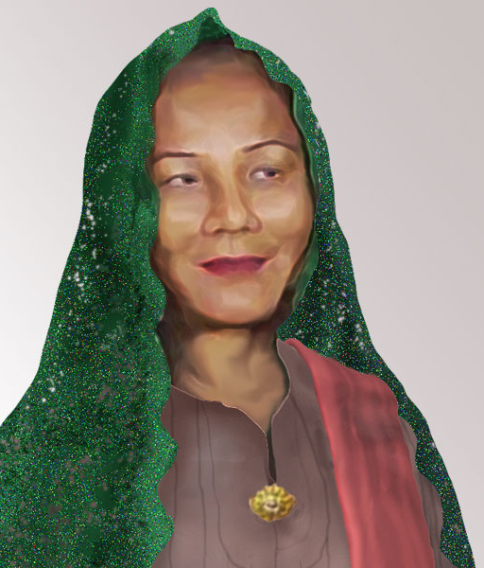
HAJJAH FATIMAH BINTE SULAIMAN
About Her
Masjid Hajjah Fatimah
Hajjah Fatimah bin Sulaiman built a successful steamship and salib oat-based trading operation.
Fatimah’s residence was burgled twice and set on fire the second time.
Grateful she was not around during the burglaries, she donated money and the land her house was on to build a mosque – Masjid Hajjah Fatimah.
Fatimah also rebuilt her own house, and funded the construction of houses for the poor on the land next to the Masjid Hajjah Fatimah.
She’s referred to as Hajjah Fatimah because she made a pilgrimage to Mecca or Hajj.
Image courtesy of Singapore Women’s Hall of Fame

Slide 5
KWA GEOK CHOO
Education
Political Work
Women’s Rights
The wife of the first Prime Minister of Singapore, Kwa Geok Choo was also the co-founder of law firm Lee & Lee.
She graduated with first-class honours from Girton College. She was admitted to the Colony Bar in 1951. She was one of the few female practicing lawyers.
She was also a founding member of the People’s Action Party, helping to draft the PAP Constitution.
Kwa Geok Choo also drafted the clauses in the Separation Agreement to guarantee the water agreements between Johor and Singapore.
She also advocated for women’s rights in Singapore, speaking on family planning and supporting legal protection for women. Her suggestions were included in the 1961 women’s charter.
Image courtesy of Wikimedia Commons.

Slide 6
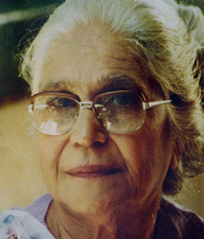
SHIRIN FOZDAR
India
Singapore
Thailand
She and a group of like-minded women established the Singapore Council of Women in 1952. It had more than 2,000 members.
She was a renowned public speaker throughout Asia before arriving in Singapore.
She was a trailblazing women’s advocate speaking out against child marriage and polygamy and the necessity of education for women.
After the 1959 elections, Shirin urged PAP to pass a women’s rights bill, outlawing polygamy and other provisions to protect women and girls.
In 1961 Shirin moved to rural Thailand, setting up a school for girls. She wanted to empower women against being forced into prostitution.
Image courtesy of Singapore Women’s Hall of Fame

Slide 7
SOPHIA BLACKMORE
Educating Girls
Missionary Work
She also set up a girls boarding home, housing many single lady missionaries, teachers, school-going girls, orphans and runaways.
A chance meeting with Reverend William Oldham in India opened the doors for her to become a missionary in Malaya.
An Australian Christian missionary, she founded the Fairfield Methodist Schools and Methodist Girls’ School.
Sophia Blackmore translated hymns and published the Baba Malay periodical Sahabat in local street Malay.
Her home became a Straits Chinese house church – now the Kampong Kapor Methodist Church - headed by Goh Hood Keng. She also preached regularly in Malay on Sundays.
Image courtesy of Wikimedia Commons

Slide 8
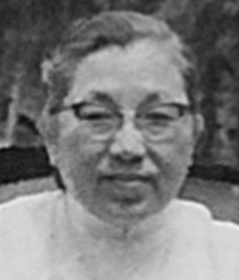
TAN CHENG HIONG
Personal Life
Women’s Rights
She was married to George Lee for 15 years and had nine children.
When he wanted a second wife, she chased him out of her home and focused on helping other women.
She met Shirin Fozdar in 1952, and became the first president of the SCW. She lobbied factories to have childcare facilities for working mothers.
Cheng Hiong also wrote to the Chinese Advisory on the unjust treatment of mistresses and concubines and the outdated practice of polygamy.
She also convinced her husband to install pulleys in his family factory to help women with bound feet carrying heavy sheets of rubber.
Image courtesy of Singapore Women’s Hall of Fame

Slide 9
ESTHER TAN CHENG YIN
Naval Career
Adventure Racing
Singapore’s first female naval diver, Esther Tan Cheng Yin specialised in search and rescue missions and bomb disposal.
Most notably, she was involved in recovering missing sailors after the collision of a container ship and the RSS Courageous in 2003.
After 22 years of service, she retired, having held the rank of Major.
In university, she started competing in adventure racing. She has competed in marathons, triathlons and Ironman Triathlons, and climbed Mount Everest in 2011.
She was the first in the Women’s Open of the Ironman 70.3 event in the Desaru Pengerang International Long Distance Triathlon.
Image courtesy of Esther’s Facebook page

Slide 10
HALIMAH YACOB
Education
Childhood
Political Career and Presidency
She helped her mother sell nasi padang along Prince Edward Road.
She is the first female Speaker of Parliament and President in Singapore.
Halimah Yacob graduated with a Masters of Law degree, and was conferred an Honorary Doctor of Law degree.
In 2019, Halimah advocated for gender equality in companies as it would increase innovation and business profitability.
She also asked for an apology from the hosts of Okletsgo for their offensive remarks against women.
Image courtesy of Wikimedia Commons

Slide 11
THERESA GOH
Swimming Career
Championing Inclusivity
Theresa is Singapore’s first Paralympic swimmer. She started competing at 12 and began to break world records in her events.
She has amassed many medals at the Asean Para Games, and other international events.
Theresa was born with congenital spina bfida, and cannot use her legs. Her left ear is also undeveloped.
She won a bronze medal in the SB4 100m breaststroke final in the 2016 Summer Paralympics.
Theresa is currently focused on championing inclusivity for marginalised groups like disability and LGBT communities.
Image courtesy of Singapore Women’s Hall of Fame

